Slide 1
JDBC

Slide 2
JDBC
Java JDBC is a java API to connect and execute query with the database.
JDBC API uses jdbc drivers to connect with the database.
Before JDBC, ODBC API was the database API to connect and execute query with the database.
ODBC API uses ODBC driver which is written in C language (i.e. platform dependent and unsecured).
So, Java has defined its own API (JDBC API) that uses JDBC drivers (written in Java language).

Slide 3
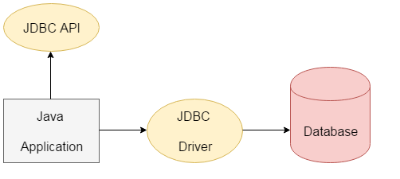
JDBC

Slide 4
JDBC Driver
JDBC Driver is a software component that enables java application to interact with the database.
There are 4 types of JDBC drivers:
JDBC-ODBC bridge driver
Native-API driver (partially java driver)
Network Protocol driver (fully java driver)
Thin driver (fully java driver)

Slide 5
JDBC-ODBC bridge driver
The JDBC-ODBC bridge driver uses ODBC driver to connect to the database.
The JDBC-ODBC bridge driver converts JDBC method calls into the ODBC function calls.
This is now discouraged because of thin driver.

Slide 6
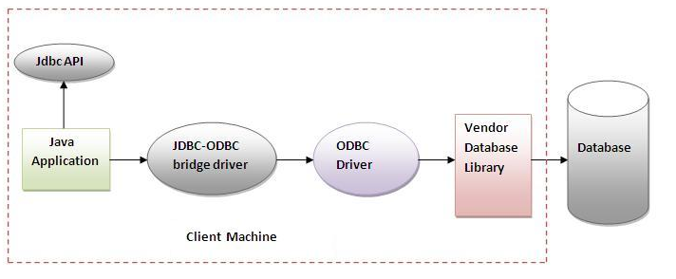
JDBC-ODBC bridge driver

Slide 7
JDBC-ODBC bridge driver
Advantages:
easy to use.
can be easily connected to any database.
Disadvantages:
Performance degraded because JDBC method call is converted into the ODBC function calls.
The ODBC driver needs to be installed on the client machine.

Slide 8
Native-API driver
The Native API driver uses the client-side libraries of the database.
The driver converts JDBC method calls into native calls of the database API.
It is not written entirely in java.

Slide 9
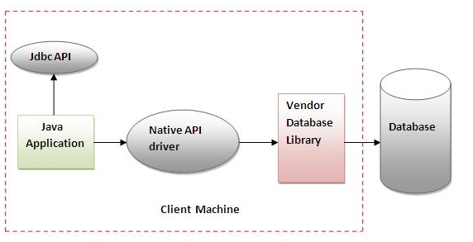
Native-API driver

Slide 10
Native-API driver
Advantage:
performance upgraded than JDBC-ODBC bridge driver.
Disadvantage:
The Native driver needs to be installed on the each client machine.
The Vendor client library needs to be installed on client machine.

Slide 11
Network Protocol driver
The Network Protocol driver uses middleware (application server) that converts JDBC calls directly or indirectly into the vendor-specific database protocol.
It is fully written in java.

Slide 12
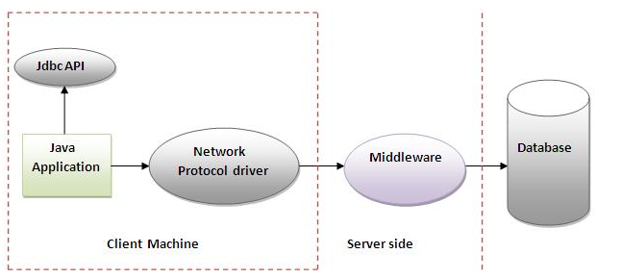
Network Protocol driver

Slide 13
Network Protocol driver
Advantage:
No client side library is required because of application server that can perform many tasks.
Disadvantages:
Network support is required on client machine.
Requires database-specific coding to be done in the middle tier.
Maintenance of Network Protocol driver becomes costly because it requires database-specific coding to be done in the middle tier.

Slide 14
Thin driver
The thin driver converts JDBC calls directly into the vendor-specific database protocol.
That is why it is known as thin driver.
It is fully written in Java language.

Slide 15
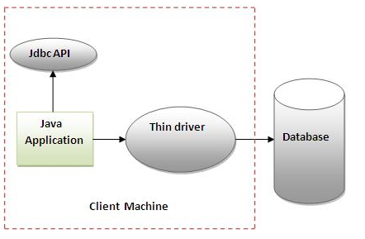
Thin driver

Slide 16
Thin driver
Advantage:
Better performance than all other drivers.
No software is required at client side or server side.
Disadvantage:
Drivers depends on the Database.

Slide 17
Steps to connect to the database
Steps to connect any java application with the database using JDBC is as follows:
Register the driver class
Creating connection
Creating statement
Executing queries
Closing connection

Slide 18
Preparing database in MySQL
Install MySQL
Open MySQL Client Application
Create a database:
create database gla;
Enter into the database created:
use gla;
Create a table with multiple fields:
create table login(id varchar(10),password varchar(10));

Slide 19
Preparing database in MySQL
Insert values in the table:
insert into login values(‘avinash’, ‘singh’);
insert into login values(‘tina’, ‘friend’);
insert into login values(‘161500322’, ‘qwerty’);
insert into login values(‘161500123’,’12312’);

Slide 20
Connecting with MySQL
import java.sql.*;
class MysqlCon{
public static void main(String args[]){
String url="jdbc:mysql://localhost:3306/gla";//gla is the database name
String dbuser=“root”;
String dbpass=“root”;
try{
Class.forName("com.mysql.jdbc.Driver");
Connection c=DriverManager.getConnection(url, dbuser, dbpass);
Statement stmt=c.createStatement();

Slide 21
Connecting with MySQL
ResultSet rs=stmt.executeQuery("select * from login");
while(rs.next())
System.out.println(rs.getString(1)+" "+rs.getString(2));
c.close();
}catch(Exception e){ System.out.println(e);}
}
}
Output:
avinash singh
tina friend
161500322 qwerty
161500123 12312

Slide 22
Question
Develop an application that asks the user to
input username and password. The program
should provide the output as:
Welcome <username>
OR
You are not an authorized user

Slide 23
Solution
import java.sql.*;
import java.util.*;
class Authorization{
public static void main(String args[]){
Scanner sc=new Scanner(System.in);
String u=sc.nextLine();
String p=sc.nextLine();
try{
Class.forName("com.mysql.jdbc.Driver");
Connection c=DriverManager.getConnection(
"jdbc:mysql://localhost:3306/gla","root","root");
Statement stmt=c.createStatement();

Slide 24
Solution
ResultSet rs=stmt.executeQuery("select * from login where username=‘ "+u+“ ' and password=‘ "+p+“ ‘ ");
if(rs.next())
System.out.println(“Welcome “+ u);
else
System.out.println("You are not authorized user");
c.close();
}catch(Exception e){ System.out.println(e);}
}
}

Slide 25
Inserting into the database
import java.sql.*;
import java.util.*;
class Authorization{
public static void main(String args[]){
Scanner sc=new Scanner(System.in);
String u=sc.nextLine();
String p=sc.nextLine();
try{
Class.forName("com.mysql.jdbc.Driver");
Connection c=DriverManager.getConnection(
"jdbc:mysql://localhost:3306/gla","root","root");
Statement stmt=c.createStatement();

Slide 26
Inserting into the database
stmt.executeUpdate(“Insert into login values(‘ “ + u + “ ‘ , ‘ "+p+“ ‘ ) ");
System.out.println(“Data Submitted successfully”);
c.close();
}catch(Exception e){ System.out.println(e);}
}
}

Slide 27
Thank You

